Slide 1
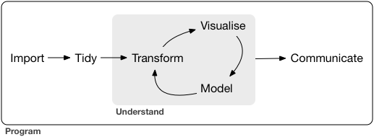
Lesson 17: Data Import and Tidy
SE370 – Computer-Aided Systems Engineering
CPT James MacGibbon- DSE- Instructor

Slide 2
Today
Lesson 17: Data Import and Tidy
1. Load flat files in R with readr package
2. Import and read data from an outside source (Flat files, Excel files, CSV)
3. Know how to tidy data in multiple ways
2

Slide 3
Next Time
Lesson 18: Data Import and Tidy
1. Clean, manipulate, and create data frames using tidyr
2. Know the difference between a tibble and a data frame.
3. Understand and apply gather(), spread(), separate(), and unite() to create the tidy format
3

